Slide 1
Randomly Wired Networks are on the rise, have we been creating wrong Networks all along?
CSE 598
Mudit Verma

Slide 2
TIMELINE
Aim
Background & Failed attempt to survey
Perspective of Cognitive Science
Analyze Xie et. al FAIR article
Implementation & Decide
Results
DIY Stuff

Slide 3
BACKGROUND Neural Architecture Search
Slow Approaches - RL / RNN / Genetic Algorithms
Weight Sharing
Evolving the network through operators (Morphism)
Generate & Test

Slide 4
BACKGROUND Neural Architecture Search
Slow Approaches - RL / RNN / Genetic Algorithms
Weight Sharing
Evolving the network through operators (Morphism)
Generate & Test
~ Opposite of Intelligence

Slide 5
AIM :
Survey - Look at Neural Architecture Search from the eyes of MCMC.

Slide 6
SURVEY
MCMC
MCMC for Deep Learning ~ Generative Models etc.
Obtain Bayesian Network DAG from data
Random Walks on Graphs, Sample Distributions …
Neural Architecture Search
Random Search on NAS (Morphisms)

Slide 7
SURVEY
MCMC
MCMC for Deep Learning ~ Generative Models etc.
Obtain Bayesian Network DAG from data
Random Walks on Graphs, Sample Distributions …
Neural Architecture Search
Random Search on NAS morphism
Xie et. al : Exploring Randomly Wired Neural Networks for Image Recognition

Slide 8
AIM :
Survey - Look at Neural Architecture Search from the eyes of MCMC.
Gain insights about importance of random wiring
Analyze Xie et. al, Agree/Disagree
Report Results
Write down some ideas

Slide 9
Importance of Random Wiring
Brain Wiring : Innate abilities are decoupled from the ones learnt in their lifetimes.
Weight initialization has minimal effect on one-shot NAS
Small-world Assumption

Slide 10
Theme
Are graphs scoring high on accuracy leaderboard random?

Slide 11
IMPLEMENTATION :
Random Graph Generation (R)
R -> DAG
R -> G (Neural Network)
Train & Test

Slide 12
IMPLEMENTATION :
Random Graph Generation (R)
R -> DAG
R -> G (Neural Network)
Train & Test
Markov Chain
Swap Edge
Stay
Add/Remove Node
Add/Remove Edge

Slide 13
IMPLEMENTATION :
Random Graph Generation (R)
R -> DAG
R -> G (Neural Network)
Train & Test
Erdos-Reyni
Graph with N Nodes
Edge with Prob. P
Notes:
No need to spend time on ER, BA & WS

Slide 14
IMPLEMENTATION :
Random Graph Generation (R)
R -> DAG
R -> G (Neural Network)
Train & Test
Barabasi-Albert Model (1 ≤ M < N). M nodes without edges
Add new nodes with M new edges.
Graph has M ∗ (N −M) edges.

Slide 15
IMPLEMENTATION :
Random Graph Generation (R)
R -> DAG
R -> G (Neural Network)
Train & Test
Watts-Strogatz Model
N nodes in a ring, each connected to (even)K/2 neighbors on both sides.
Rewire with Prob P
Repeated K/2 times

Slide 16
IMPLEMENTATION :
Random Graph Generation (R)
R -> DAG
R -> G (Neural Network)
Train & Test
Add a Root and Sink
In
Out

Slide 17
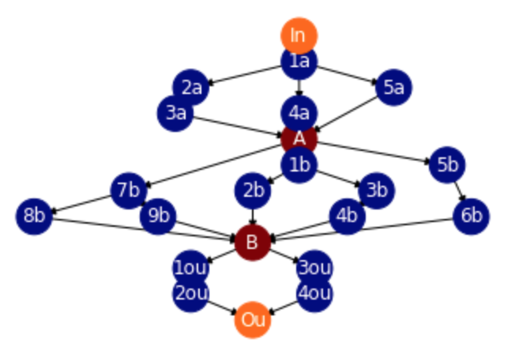
IMPLEMENTATION :
Random Graph Generation (R)
R -> DAG
R -> G (Neural Network)
Train & Test

Slide 18
IMPLEMENTATION :
Random Graph Generation (R)
R -> DAG
R -> G (Neural Network)
Train & Test
ReLU + Conv + BN
Handle inChannels / outChannels
Operations at joints

Slide 19
IMPLEMENTATION :
Random Graph Generation (R)
R -> DAG
R -> G (Neural Network)
Train & Test
Experiments
MNIST
24 MC Graphs
12 ER ..
12 BA ..
12 WS ..
Same hyper params
Varying Algorithm priors

Slide 20
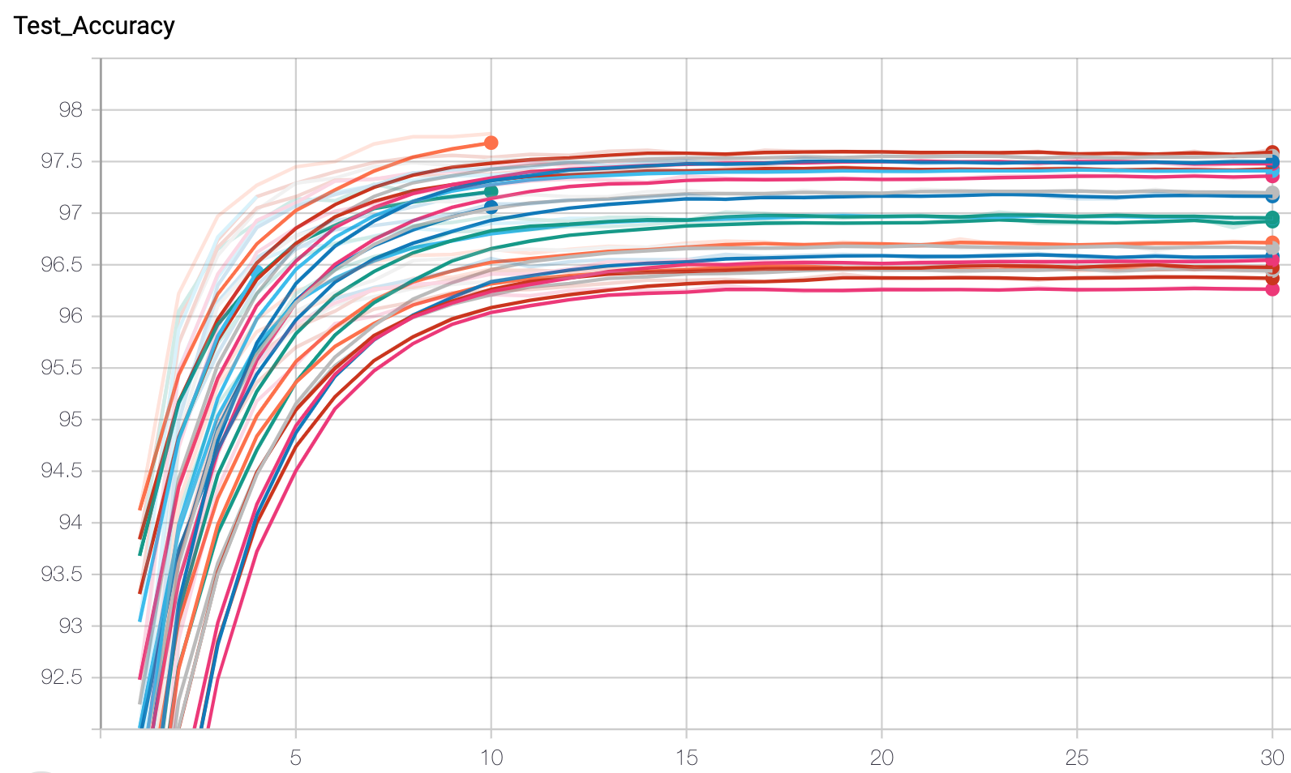
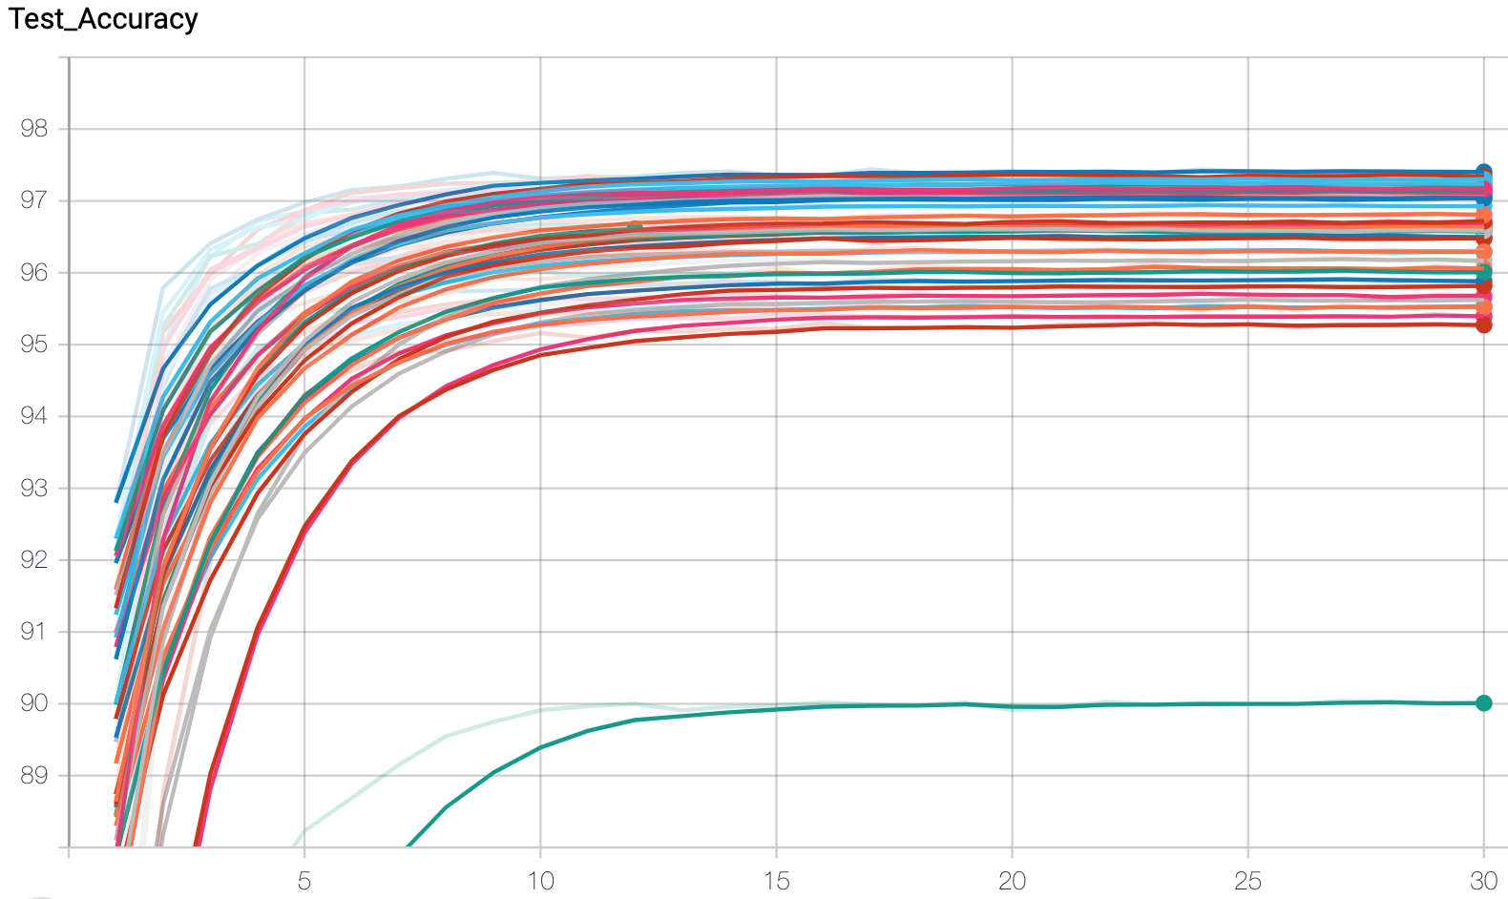
RESULTS Accuracy Curves
96.25 - 97.5
95 - 97
MC Graphs
ER/BA/WS
MC > Others?

Slide 21
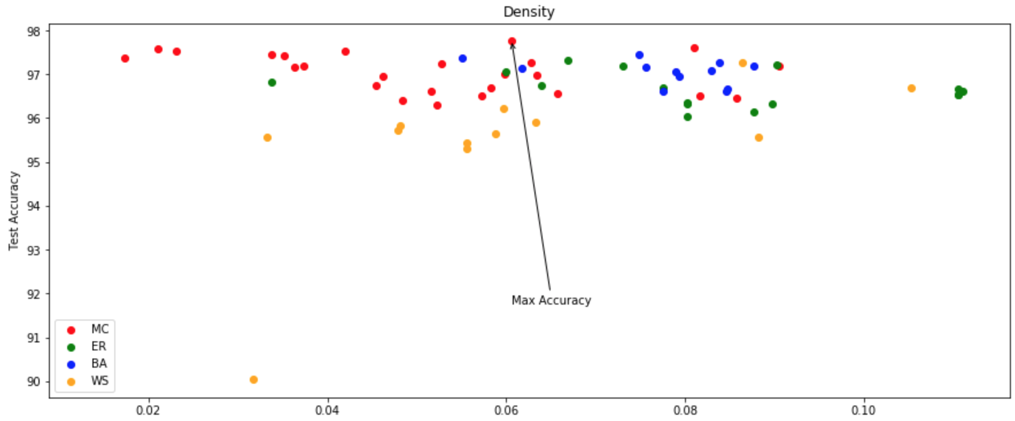
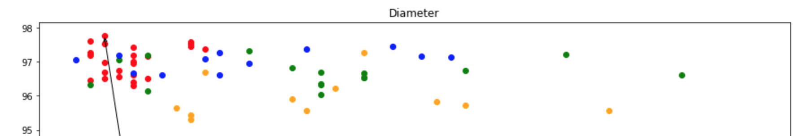
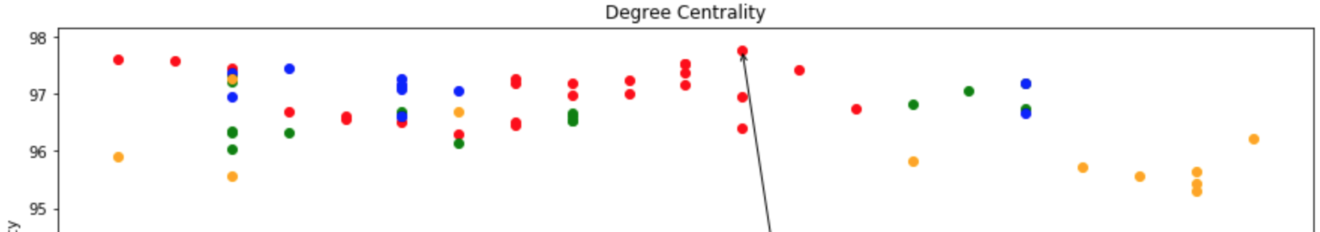
RESULTS DENSITY, DIAMETER, DEGREE CENTRALITY

Slide 22
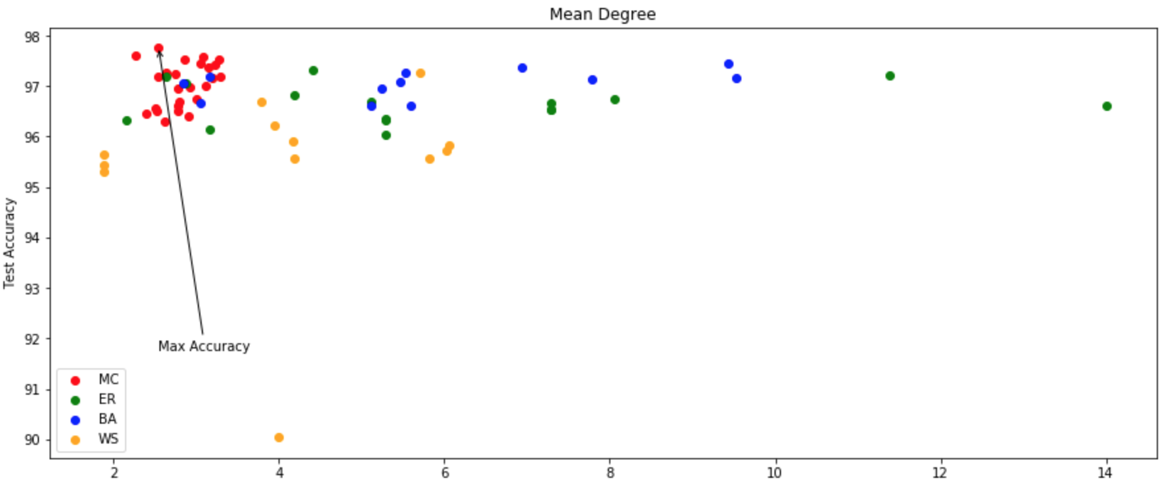
RESULTS MEAN DEGREE

Slide 23
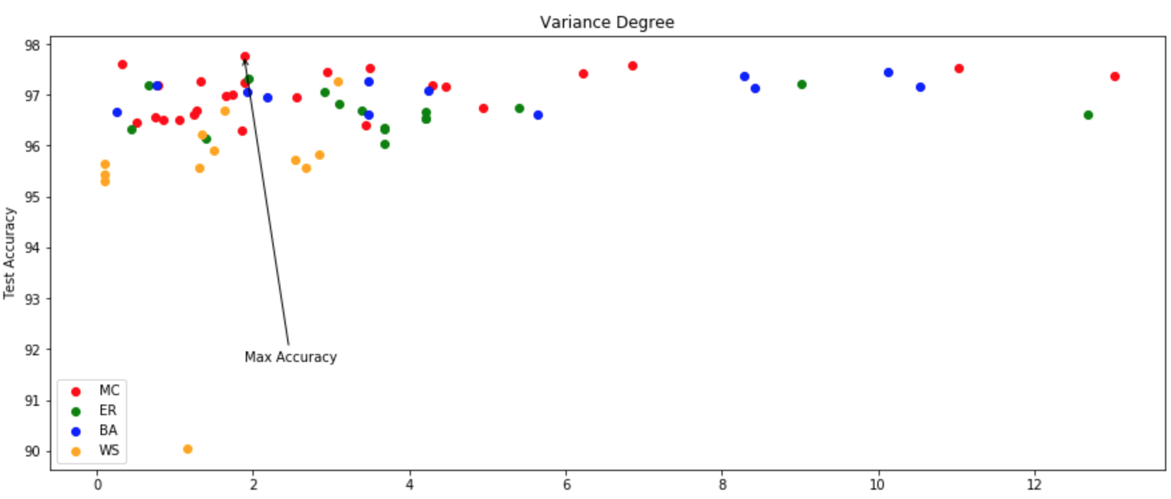
RESULTS VARIANCE
Spread : BA > MC ~ ER > WS

Slide 24
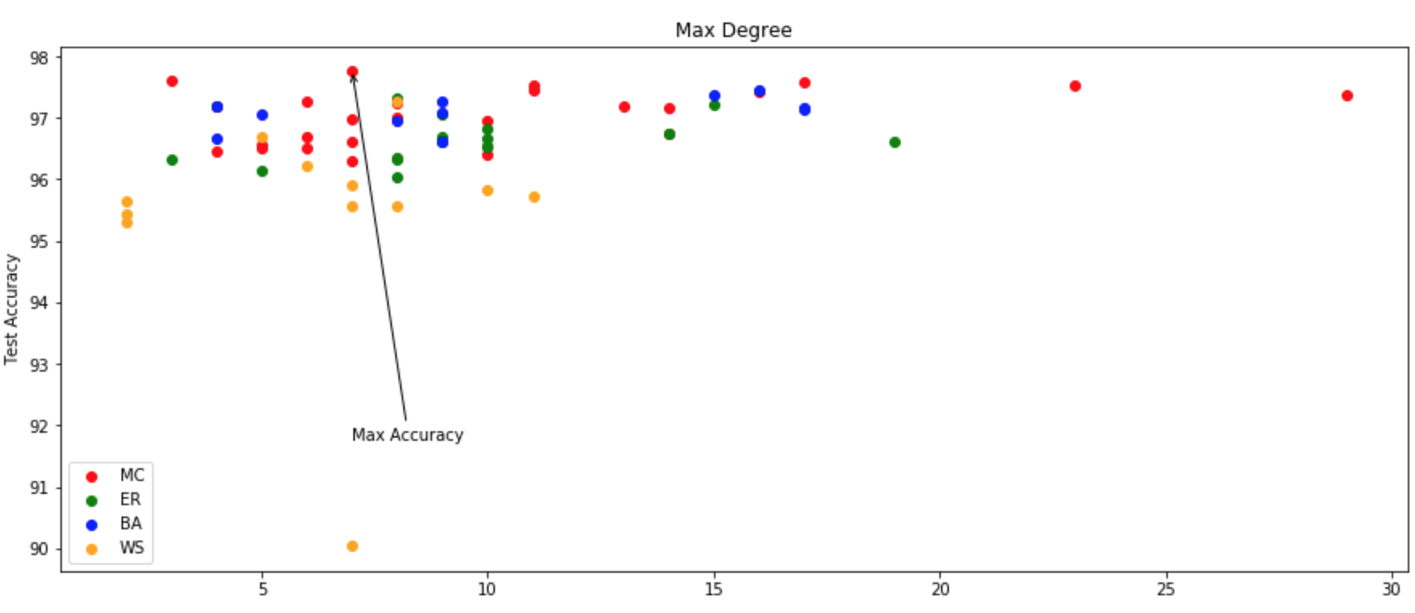
RESULTS

Slide 25
Random Wiring, Verdict?
Cons :
Patterns in Random Graph vs Acc
Other NAS are better (Use acc. to evolve)
Overparameterization
Pros:
Shatters works claiming to contribute to “architecture” by wiring.
graph properties and the input size -> “goodness" of architecture

Slide 26
FUTURE WORK
Bootstrapping : Collect “good architectures”, sample graphs conditioned on these.
Multi Layered Markov Chain : Decide Architecture Decide Mapping / Mapping distribution Dimension Compatibility? Slow mixing?

Slide 27
CONCLUSION
Importance of Wiring.
Critique
Experiments
Random graphs are not equal.
Claim : Architecture -> image dimensions (amt.info > info)
Notes:
Least dimens with highest Explained Var.

